Slide 1



DEFUSE-X
Presents
BOMB DEFUSAL GAME
Entertainment, Creativity, and the Focus
Team Members:
36.Darsh
45.Aditya
57.Pratham
65.Gauri

Slide 2

DEFUSE-X
PROBLEM STATEMENT
In today’s digital age, children are increasingly exposed to instant content, reducing their attention span, lack of focus and decrease in problem solving skills.

Slide 3
DEFUSE-X
SOLUTION - BOMB DIFFUSAL GAME
To address this issue, a Bomb Defusal Game is developed as an interactive learning system.
The game presents time-based challenges that require focus, logical thinking, and quick decision-making.
Users must solve puzzles, decode patterns, or enter correct inputs to “defuse” the bomb.
This creates a sense of urgency, improving concentration and engagement.
Overall, the system enhances problem-solving skills in a fun and practical way.

Slide 4
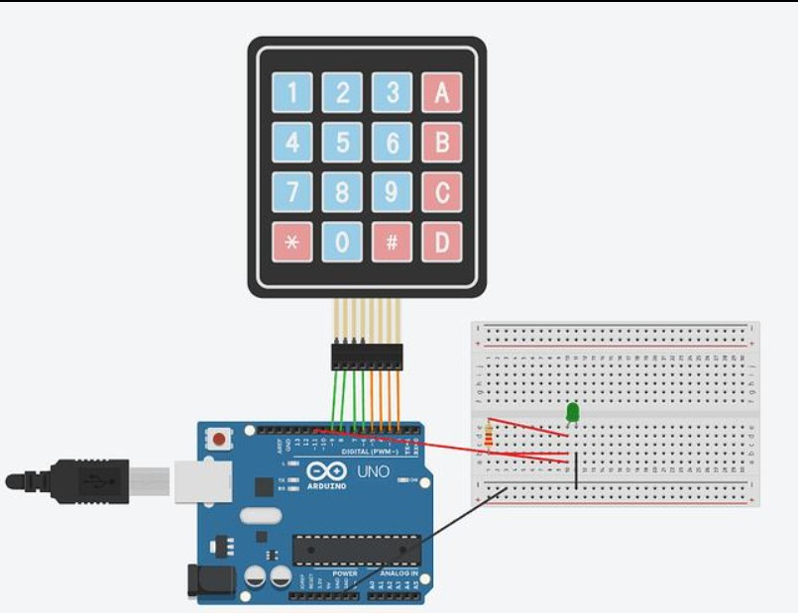
DEFUSE-X
WORKING
LCD displays math questions and countdown timer
Keypad used to enter answers
Correct answer → next question
All answers are submitted and stored internally
Includes medium and hard difficulty modes
Improves calculation speed and reaction time
Final output: Bomb Defused 💥 / Bomb Not Defused

Slide 5

DEFUSE-X
APPLICATIONS
Helps kids improve basic math skills (addition, subtraction, multiplication)
Makes learning fun through a game-based activity
Builds quick thinking and problem-solving ability
Improves focus and concentration under time pressure
Encourages interest in electronics and coding through interactive learning

Slide 6
THANK YOU

